Slide 1
Understanding IPC’s Psoriasis Severity Reclassification
Criteria, Rationale, and Real-World Implementation
Date published: June 2025

Slide 2
RECLASSIFICATION OF PSORIASIS SEVERITY
A GLOBAL CONSENSUS
  Overview and Aim: Objectives of Delphi Study for Severity Reclassification
  Simplify the classification, making it applicable to both current clinical use and future clinical trials
  Consider real-world use of biologic/systemic medications
  Update guidelines of care
  Influence payors
International Psoriasis Council Board Members and Councilors. Recategorization of Psoriasis Severity: Delphi Consensus from the International Psoriasis Council. Strober B, Ryan C, van de Kerkhof P, et al. J Am Acad Dermatol. 2020 Jan;82(1):117-122. doi: 10.1016/j.jaad.2019.08.026. Epub 2019 Aug 16. PMID: 31425723.

Slide 3
RECLASSIFICATION OF PSORIASIS SEVERITY
A GLOBAL CONSENSUS
  Why It’s Important: Consequences of Misclassification
  Clinical trials with rigid cutoffs omit vital groups: Those with lower BSA/PASI requiring systemic/biologic therapies
    Scant information on safety and efficacy for those patients
  Reimbursement refusals: National health systems and insurers might decline coverage for patients “not allowed by the label”
  Undertreatment by dermatologists
International Psoriasis Council Board Members and Councilors. Recategorization of Psoriasis Severity: Delphi Consensus from the International Psoriasis Council. Strober B, Ryan C, van de Kerkhof P, et al. J Am Acad Dermatol. 2020 Jan;82(1):117-122. doi: 10.1016/j.jaad.2019.08.026. Epub 2019 Aug 16. PMID: 31425723.

Slide 4

RECLASSIFICATION OF PSORIASIS SEVERITY
A GLOBAL CONSENSUS
  Consensus Methodology: How It Was Done
  Approach: Modified Delphi method engaging international psoriasis experts.
  Participants: IPC’s global network of dermatology specialists.
  Process: Several rounds of structured discussions and voting to reach consensus on redefining severity criteria, aiming to create practical, patient-centered guidelines that enhance clinical decision-making.
International Psoriasis Council Board Members and Councilors. Recategorization of Psoriasis Severity: Delphi Consensus from the International Psoriasis Council. Strober B, Ryan C, van de Kerkhof P, et al. J Am Acad Dermatol. 2020 Jan;82(1):117-122. doi: 10.1016/j.jaad.2019.08.026. Epub 2019 Aug 16. PMID: 31425723.

Slide 5

RECLASSIFICATION OF PSORIASIS SEVERITY
A GLOBAL CONSENSUS
  Key Findings
  The traditional “mild, moderate, severe” classification is overly simplistic and may not capture the true burden of the disease.
  Quality of life impacts must be considered alongside clinical measures like PASI and BSA.
  Systemic therapy should be accessible based on practical, patient-centered criteria rather than rigid thresholds.
International Psoriasis Council Board Members and Councilors. Recategorization of Psoriasis Severity: Delphi Consensus from the International Psoriasis Council. Strober B, Ryan C, van de Kerkhof P, et al. J Am Acad Dermatol. 2020 Jan;82(1):117-122. doi: 10.1016/j.jaad.2019.08.026. Epub 2019 Aug 16. PMID: 31425723.

Slide 6

RECLASSIFICATION OF PSORIASIS SEVERITY
A GLOBAL CONSENSUS
  New Criteria
New Criteria for Systemic Therapy Candidacy:
Patients meeting one or more of the following criteria are candidates for systemic therapy:
  Psoriasis affecting ≥10% of Body Surface Area (BSA)
  Lesions on high-impact sites: Face, palms, soles, genitalia, scalp, and nails
  Failure of topical therapies to control symptoms
International Psoriasis Council Board Members and Councilors. Recategorization of Psoriasis Severity: Delphi Consensus from the International Psoriasis Council. Strober B, Ryan C, van de Kerkhof P, et al. J Am Acad Dermatol. 2020 Jan;82(1):117-122. doi: 10.1016/j.jaad.2019.08.026. Epub 2019 Aug 16. PMID: 31425723.

Slide 7

RECLASSIFICATION OF PSORIASIS SEVERITY
A GLOBAL CONSENSUS
  Criteria 1: Body Surface Area (BSA)
BSA is calculated by totaling the affected skin area, assuming the head is 10%, the arms are 20%, the trunk is 30%, and the legs are 40% of the total body surface.
BSA is estimated by the palm method where a patient’s palm = 1% of their body’s surface area:
  Head and Neck = 10% (10 palms)
  Upper extremities = 20% (20 palms)
  Trunk (axillae and groin) = 30% (30 palms)
  Lower extremities (buttocks) = 40% (40 palms)
If the total affected BSA is >10%, the patient
is a candidate for systemic therapy.
A patient’s palm = 1% of their
body’s surface area
International Psoriasis Council Board Members and Councilors. Recategorization of Psoriasis Severity: Delphi Consensus from the International Psoriasis Council. Strober B, Ryan C, van de Kerkhof P, et al. J Am Acad Dermatol. 2020 Jan;82(1):117-122. doi: 10.1016/j.jaad.2019.08.026. Epub 2019 Aug 16. PMID: 31425723.

Slide 8
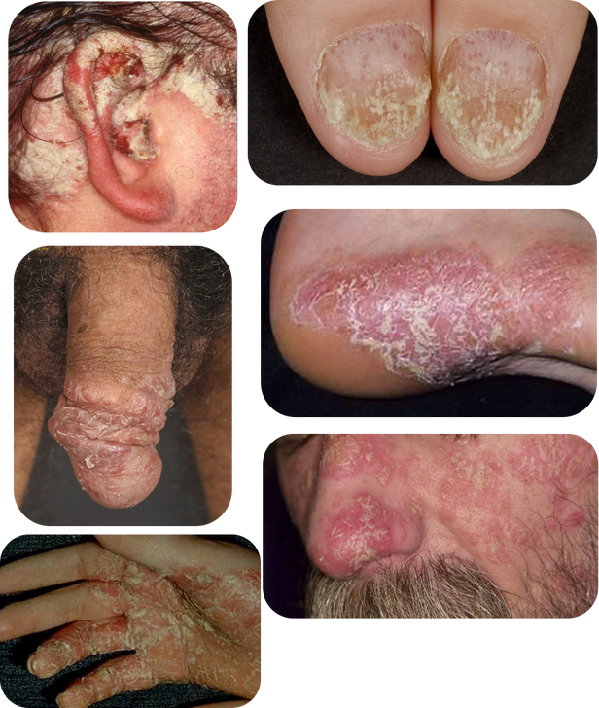
RECLASSIFICATION OF PSORIASIS SEVERITY
A GLOBAL CONSENSUS
  Criteria 2: Disease Involving High-impact Sites
If psoriasis lesions are present on one or more
high-impact sites, including:
  Face
  Palms
  Soles
  Genitalia
  Scalp
  Nails
the patient is a candidate for systemic therapy
Photos courtesy of Peter van de Kerkhof, MD, PhD, Lone Skov, MD, PhD, and Ulrich Mrowietz, MD, PhD
International Psoriasis Council Board Members and Councilors. Recategorization of Psoriasis Severity: Delphi Consensus from the International Psoriasis Council. Strober B, Ryan C, van de Kerkhof P, et al. J Am Acad Dermatol. 2020 Jan;82(1):117-122. doi: 10.1016/j.jaad.2019.08.026. Epub 2019 Aug 16. PMID: 31425723.

Slide 9
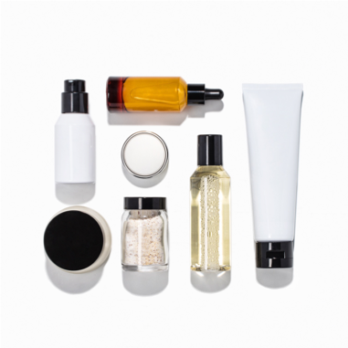
RECLASSIFICATION OF PSORIASIS SEVERITY
A GLOBAL CONSENSUS
  Criteria 3: Failure of Topical Therapy
The inability to achieve clear/nearly clear skin (BSA ≤1%, PGA 0 or 1) after two consecutive 4-week topical therapy courses, per guidelines.
Strong consideration should be given when a patient self-reports moderate or severe psoriasis, despite a provider’s mild assessment, and experiences significant physical, psychological, or social impact.
Align treatment decisions with regional guidelines and tailor to specific clinical scenarios, including age, comorbidities, presentation, and adherence.
If effective systemic therapies are inaccessible, continuing topical treatments, even if less effective, may be appropriate, provided they are customized to the patient’s clinical profile and regional recommendations.
International Psoriasis Council Board Members and Councilors. Recategorization of Psoriasis Severity: Delphi Consensus from the International Psoriasis Council. Strober B, Ryan C, van de Kerkhof P, et al. J Am Acad Dermatol. 2020 Jan;82(1):117-122. doi: 10.1016/j.jaad.2019.08.026. Epub 2019 Aug 16. PMID: 31425723.
Establishing Consensus on Defining Failure of Topical Therapy in Psoriasis: Recommendations from the International Psoriasis Council; Strober, Bruce E. et al. Journal of the American Academy of Dermatology, Volume 0, Issue 0 https://doi.org/10.1016/j.jaad.2025.08.116

Slide 10

RECLASSIFICATION OF PSORIASIS SEVERITY
A GLOBAL CONSENSUS
  Impact and Meaning
  Broader Access to Treatments: Ensures more patients receive appropriate therapy, even if they don’t meet traditional PASI/BSA thresholds.
  Patient-Centered: Considers quality-of-life impact beyond clinical scores.
  Clinical Relevance: Aligns treatment decisions with the true burden of disease.
International Psoriasis Council Board Members and Councilors. Recategorization of Psoriasis Severity: Delphi Consensus from the International Psoriasis Council. Strober B, Ryan C, van de Kerkhof P, et al. J Am Acad Dermatol. 2020 Jan;82(1):117-122. doi: 10.1016/j.jaad.2019.08.026. Epub 2019 Aug 16. PMID: 31425723.

Slide 11
Global Adoption and Supporting Evidence
The following slides highlight how the IPC reclassification is being used in clinical trials, treatment guidelines, and patient-centered studies.

Slide 12

RECLASSIFICATION OF PSORIASIS SEVERITY
A GLOBAL CONSENSUS
  Documenting the Burden of Disease Beyond BSA and PASI
2023 Study with the NPF:
Psoriasis on High-Impact Sites: Driving Symptoms, Depression,
and Quality of Life Decline
International Psoriasis Council Board Members and Councilors. Recategorization of Psoriasis Severity: Delphi Consensus from the International Psoriasis Council. Strober B, Ryan C, van de Kerkhof P, et al. J Am Acad Dermatol. 2020 Jan;82(1):117-122. doi: 10.1016/j.jaad.2019.08.026. Epub 2019 Aug 16. PMID: 31425723.

Slide 13
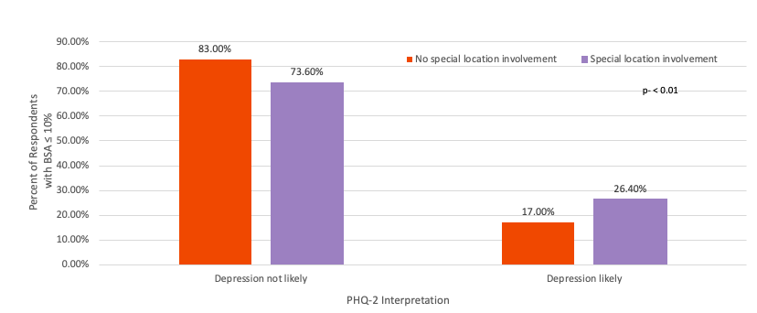
RECLASSIFICATION OF PSORIASIS SEVERITY
A GLOBAL CONSENSUS
  NPF (US) Survey: Depression
Participants with BSA ≤ 10%: depression and high-impact location involvement are related (p < 0.01).
Blauvelt A, et al. J Psoriasis Psoriatic Arthritis. 2023 Jul;8(3):100-106. doi: 10.1177/24755303231160683. Epub 2023 Mar 17.
International Psoriasis Council Board Members and Councilors. Recategorization of Psoriasis Severity: Delphi Consensus from the International Psoriasis Council. Strober B, Ryan C, van de Kerkhof P, et al. J Am Acad Dermatol. 2020 Jan;82(1):117-122. doi: 10.1016/j.jaad.2019.08.026. Epub 2019 Aug 16. PMID: 31425723.

Slide 14
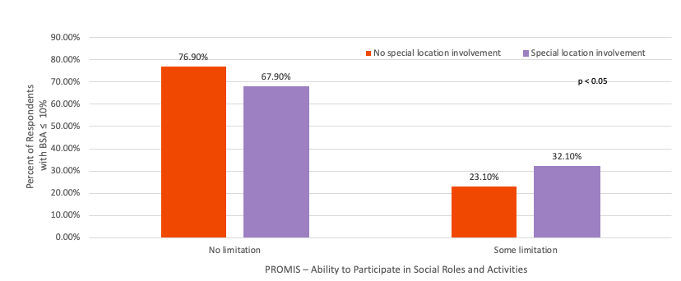
RECLASSIFICATION OF PSORIASIS SEVERITY
A GLOBAL CONSENSUS
  NPF (US) Survey: Activity Participation
Participants with BSA ≤ 10%: ability to participate in social roles and activities and high-impact location involvement are related (p < 0.05).
Blauvelt A, et al. J Psoriasis Psoriatic Arthritis. 2023 Jul;8(3):100-106. doi: 10.1177/24755303231160683. Epub 2023 Mar 17.
International Psoriasis Council Board Members and Councilors. Recategorization of Psoriasis Severity: Delphi Consensus from the International Psoriasis Council. Strober B, Ryan C, van de Kerkhof P, et al. J Am Acad Dermatol. 2020 Jan;82(1):117-122. doi: 10.1016/j.jaad.2019.08.026. Epub 2019 Aug 16. PMID: 31425723.

Slide 15

RECLASSIFICATION OF PSORIASIS SEVERITY
A GLOBAL CONSENSUS
  Encouraging Industry to Include the New Classification in Future Clinical Trials
New Clinical Trials Utilizing the Classification
International Psoriasis Council Board Members and Councilors. Recategorization of Psoriasis Severity: Delphi Consensus from the International Psoriasis Council. Strober B, Ryan C, van de Kerkhof P, et al. J Am Acad Dermatol. 2020 Jan;82(1):117-122. doi: 10.1016/j.jaad.2019.08.026. Epub 2019 Aug 16. PMID: 31425723.

Slide 16
RECLASSIFICATION OF PSORIASIS SEVERITY
A GLOBAL CONSENSUS
  Industry Conducted Multiple Clinical Trials with a Focus on High-impact, Low BSA
cdS
STUDY
DRUG AND STUDY POPULATION
IXORA-Q | Ixekizumab in patients with moderate to severe genital psoriasis
DISCREET | Apremilast in patients with moderate to severe genital psoriasis
G-PLUS | Guselkumab in nonpustular palmolantar psoriasis
REACH | Adalimumab in patients with moderate to chronic plaque psoriasis of hands and feet
GESTURE | Secukinumab in palmoplantar psoriasis
IMMprint | Risankizumab in patients with moderate to severe plaque psoriasis with non-pustular palmoplantar involvement
STYLE | Apremilast in patients with moderate to severe plaque psoriasis of the scalp
Secukinumab in Patients with Scalp Psoriasis | Secukinumab in patients with moderate to severe scalp psoriasis
PSORIATYK SCALP | Deucravacitinib in patients with scalp psoriasis
SPECTREM | Guselkumab in patients with low BSA and involvement of high-impact sites
GULLIVER | Guselkumab in patients with facial (FP) and genital psoriasis (GP)
International Psoriasis Council Board Members and Councilors. Recategorization of Psoriasis Severity: Delphi Consensus from the International Psoriasis Council. Strober B, Ryan C, van de Kerkhof P, et al. J Am Acad Dermatol. 2020 Jan;82(1):117-122. doi: 10.1016/j.jaad.2019.08.026. Epub 2019 Aug 16. PMID: 31425723.

Slide 17

RECLASSIFICATION OF PSORIASIS SEVERITY
A GLOBAL CONSENSUS
  Incorporating the New Classification into National Treatment Guidelines
Inclusion in Treatment Guidelines
International Psoriasis Council Board Members and Councilors. Recategorization of Psoriasis Severity: Delphi Consensus from the International Psoriasis Council. Strober B, Ryan C, van de Kerkhof P, et al. J Am Acad Dermatol. 2020 Jan;82(1):117-122. doi: 10.1016/j.jaad.2019.08.026. Epub 2019 Aug 16. PMID: 31425723.

Slide 18
RECLASSIFICATION OF PSORIASIS SEVERITY
A GLOBAL CONSENSUS
  National & Regional Guidelines Reflecting Components of the IPC Definition Before the Delphi
  Germany – 2011; updated in 2024
  Europe (NICE) – 2012; updated in 2017
  Spain – 2016
  Italy – 2017
  Colombia – 2018; updated in 2022
  France – 2019
  United States – 2019
International Psoriasis Council Board Members and Councilors. Recategorization of Psoriasis Severity: Delphi Consensus from the International Psoriasis Council. Strober B, Ryan C, van de Kerkhof P, et al. J Am Acad Dermatol. 2020 Jan;82(1):117-122. doi: 10.1016/j.jaad.2019.08.026. Epub 2019 Aug 16. PMID: 31425723.

Slide 19
RECLASSIFICATION OF PSORIASIS SEVERITY
A GLOBAL CONSENSUS
  National & Regional Guidelines Reflecting Components of the IPC Definition since the Delphi
  United Kingdom – 2020
  Europe (EDF) – 2020
  Mexico – 2021
  Thailand – 2022
  Denmark – 2023
  Korea – 2023
  Australia – 2023
  Finland – 2024
  Japan – 2024
International Psoriasis Council Board Members and Councilors. Recategorization of Psoriasis Severity: Delphi Consensus from the International Psoriasis Council. Strober B, Ryan C, van de Kerkhof P, et al. J Am Acad Dermatol. 2020 Jan;82(1):117-122. doi: 10.1016/j.jaad.2019.08.026. Epub 2019 Aug 16. PMID: 31425723.

Slide 20

RECLASSIFICATION OF PSORIASIS SEVERITY
A GLOBAL CONSENSUS
  Conclusion and Future Directions
  Ongoing Research: Continued evaluation of severity criteria as new data emerge.
  Call for Action: Adoption of the new consensus criteria in clinical practice to improve patient outcomes and standardize care globally.
International Psoriasis Council Board Members and Councilors. Recategorization of Psoriasis Severity: Delphi Consensus from the International Psoriasis Council. Strober B, Ryan C, van de Kerkhof P, et al. J Am Acad Dermatol. 2020 Jan;82(1):117-122. doi: 10.1016/j.jaad.2019.08.026. Epub 2019 Aug 16. PMID: 31425723.

Slide 21
